Slide 1


Cavernous Expedition
Procedural generation of caves
Mihai-Cosmin Roșu
Thesis advisor
Conf. dr. ing. Anca Morar

Slide 2
Introduction
Why?
Adventure games that include puzzles require hand crafted levels
Could procedural generation be used instead?
What is Cavernous Expedition?
3D singleplayer adventure puzzle game taking place inside an underground cave system
Uses procedural generation to create the terrain
Puzzles chosen from a premade pool

Slide 3
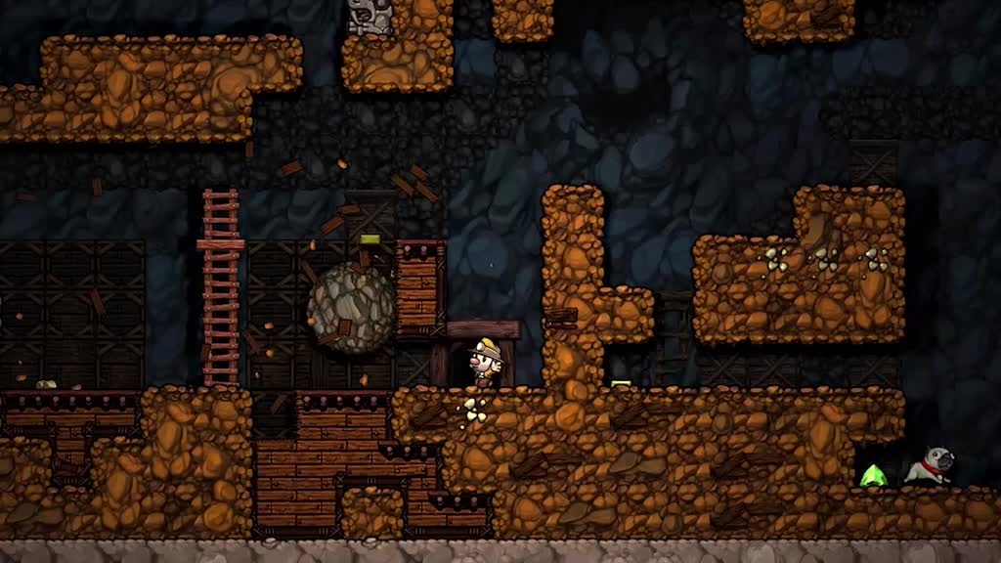
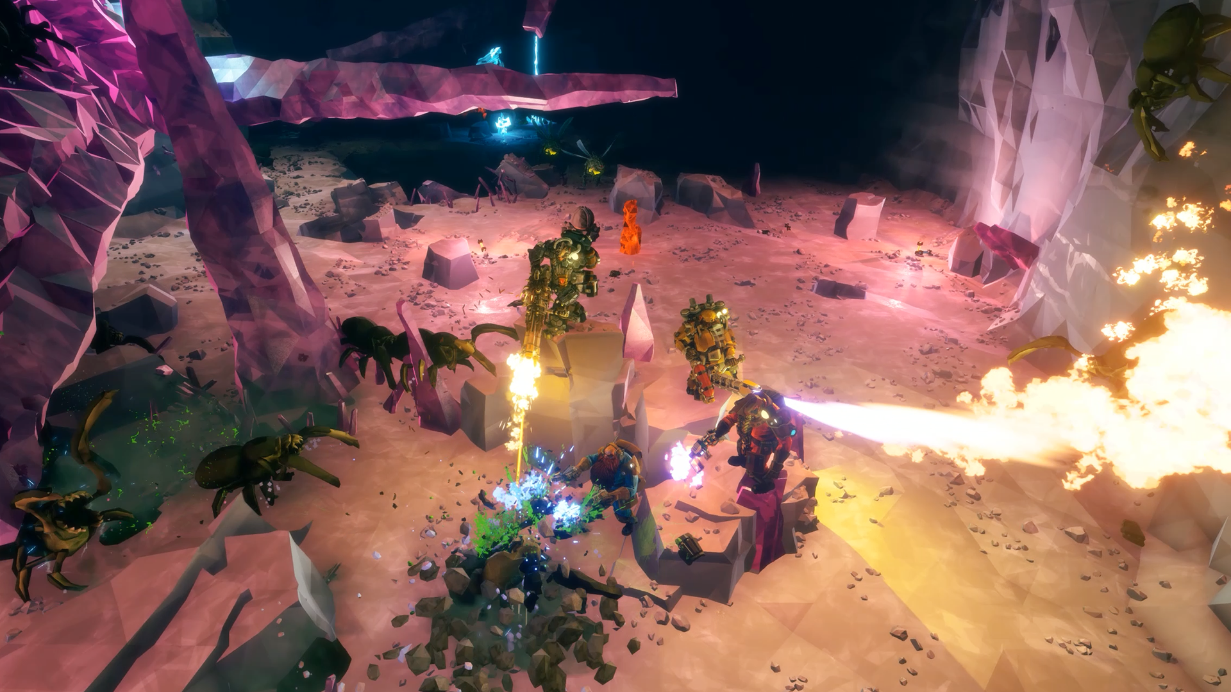
Market research
Adventure puzzle games
Portal series
We Were Here series
Procedural generation games
Spelunky
Don’t Starve
Minecraft
Deep Rock Galactic
Spelunky
Deep Rock Galactic

Slide 4
Objectives
Dynamically generated cave system
Various cave types
Resource placement
Puzzles
Resource management
Batteries – light level
Food and water – hunger level
Challenges and exploring
Puzzle solving
Surroundings information
Mapping

Slide 5
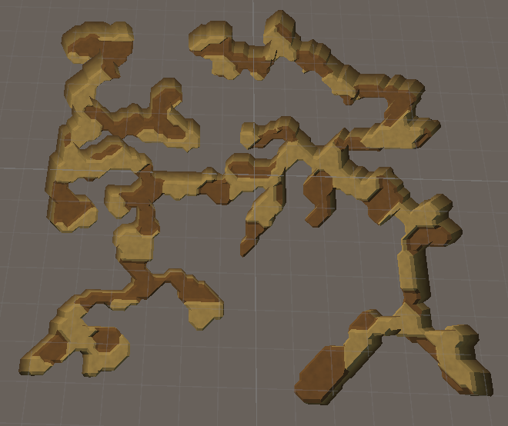
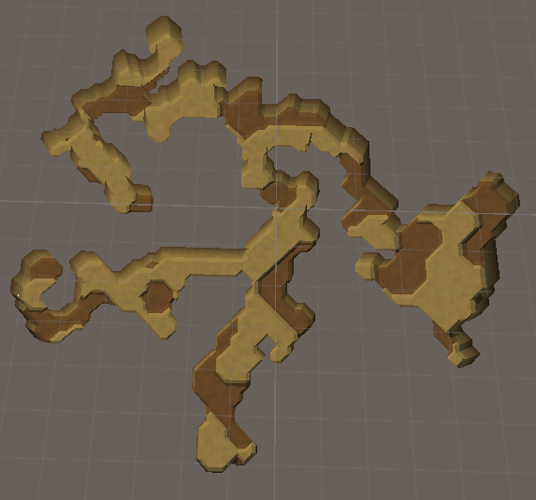
Terrain
Examples of generated cave systems (top-down view)

Slide 6
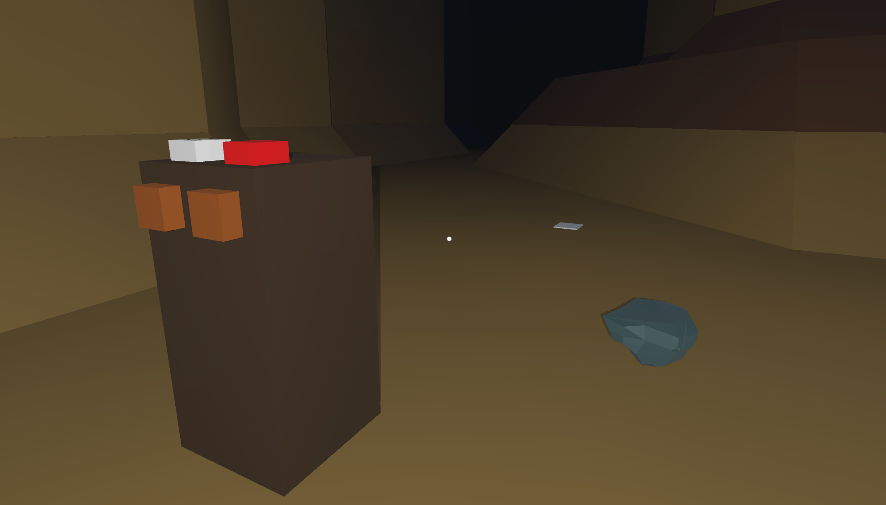
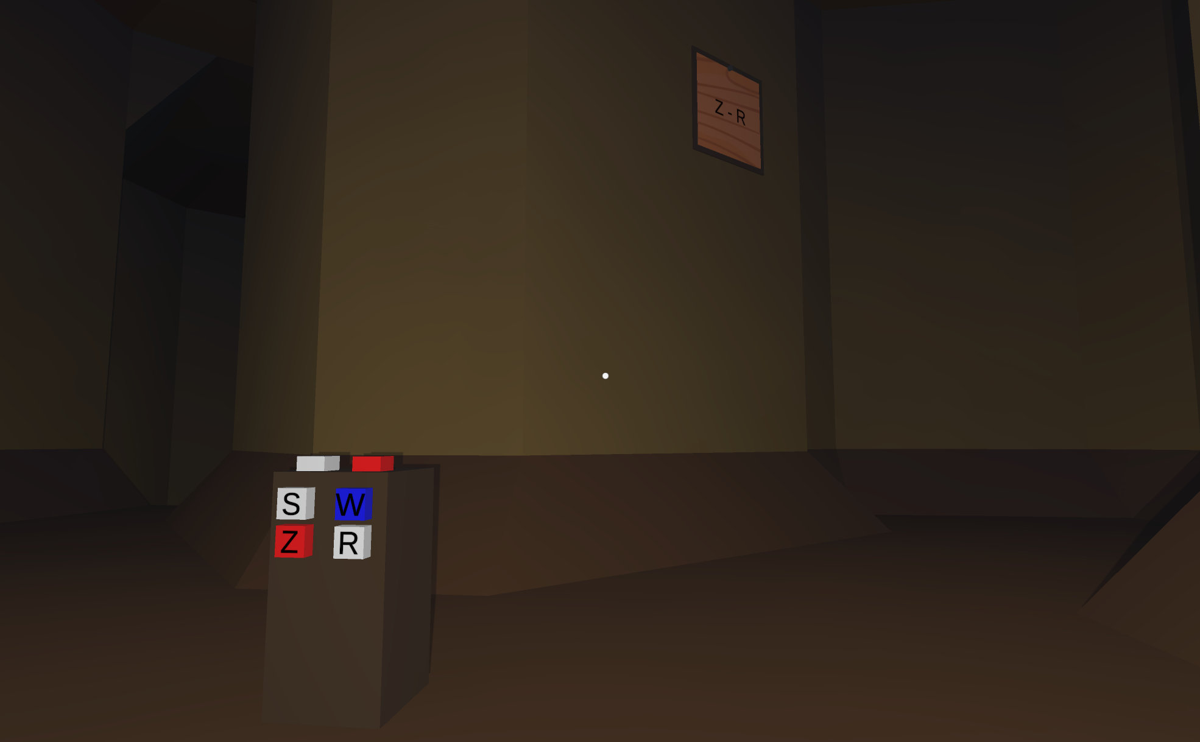
Puzzles
Multiple buttons pressed
Hold multiple buttons pressed simultaneously
Step on the buttons
Search for heavy rocks
Symbol matching
Match symbols by coloring them in pairs
Hints with the correct pairs can be found
Multiple buttons pressed
Symbol matching

Slide 7
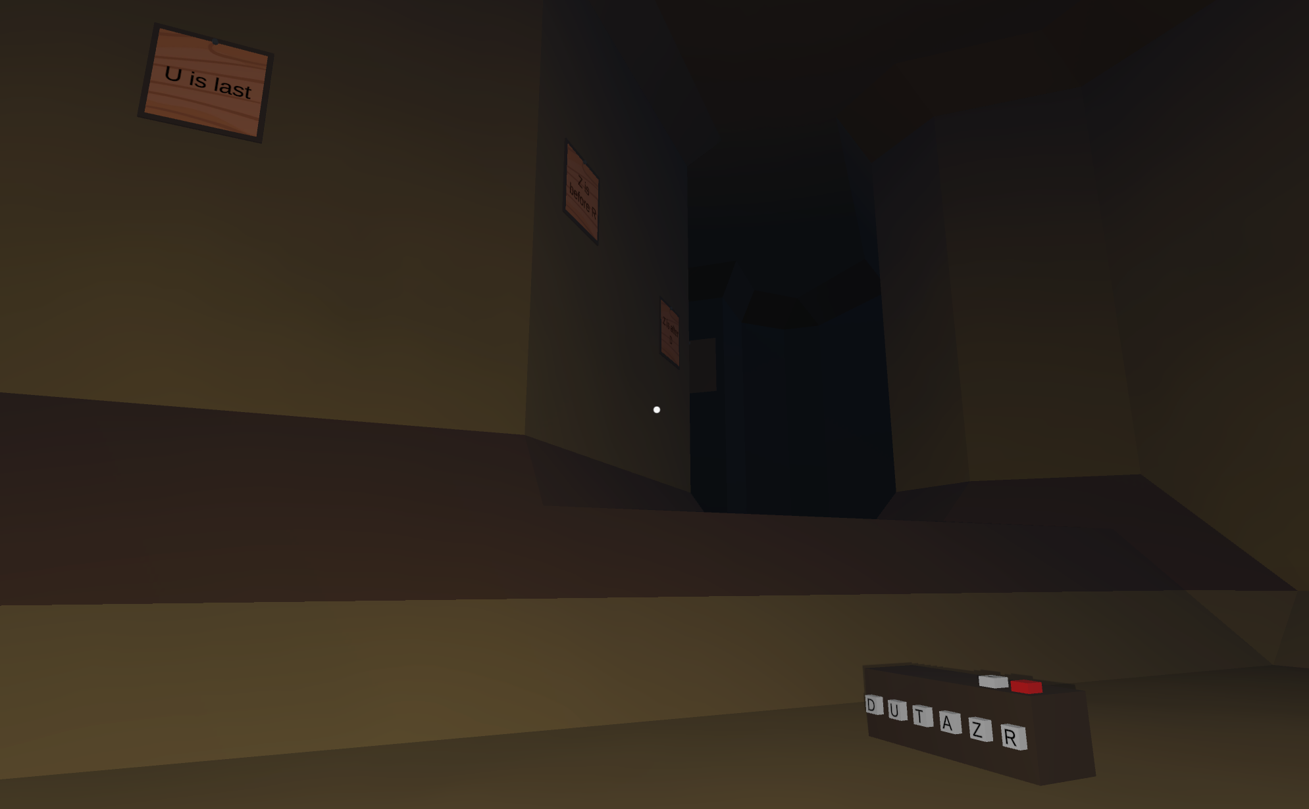
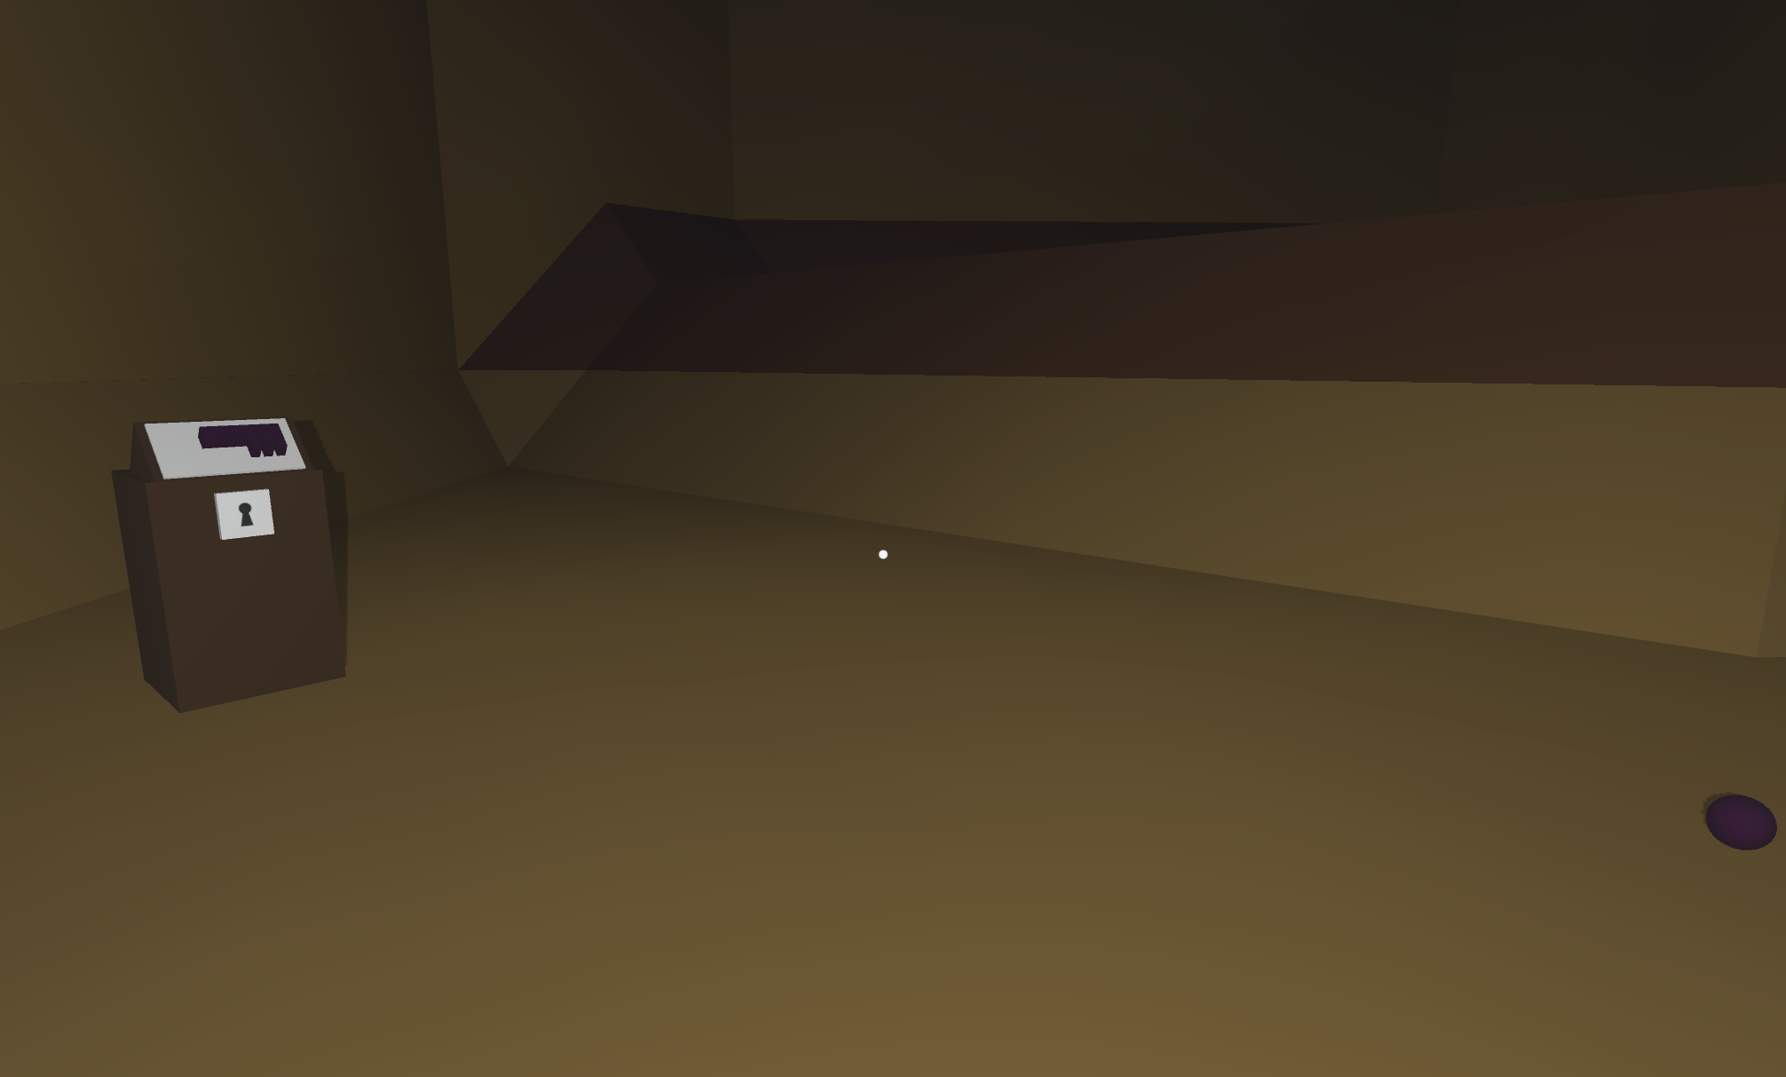
Puzzles
Symbol ordering
Order multiple symbols in a certain way
Swap the symbols to change order
Hints suggesting the correct order can be found
Assembling a key
Search for multiple key fragments
Place the fragments on the white board
Craft the key and use inside the key hole
Symbol ordering
Assembling a key

Slide 8
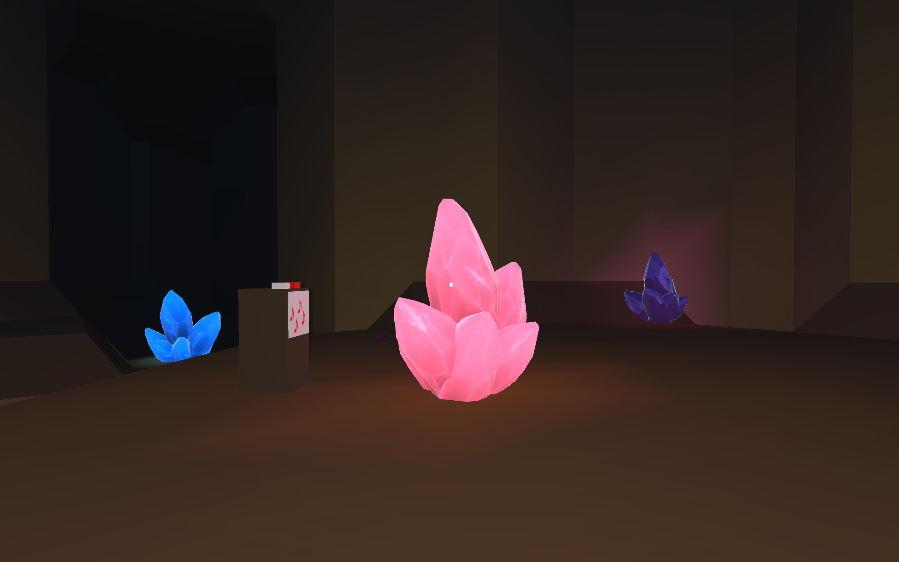
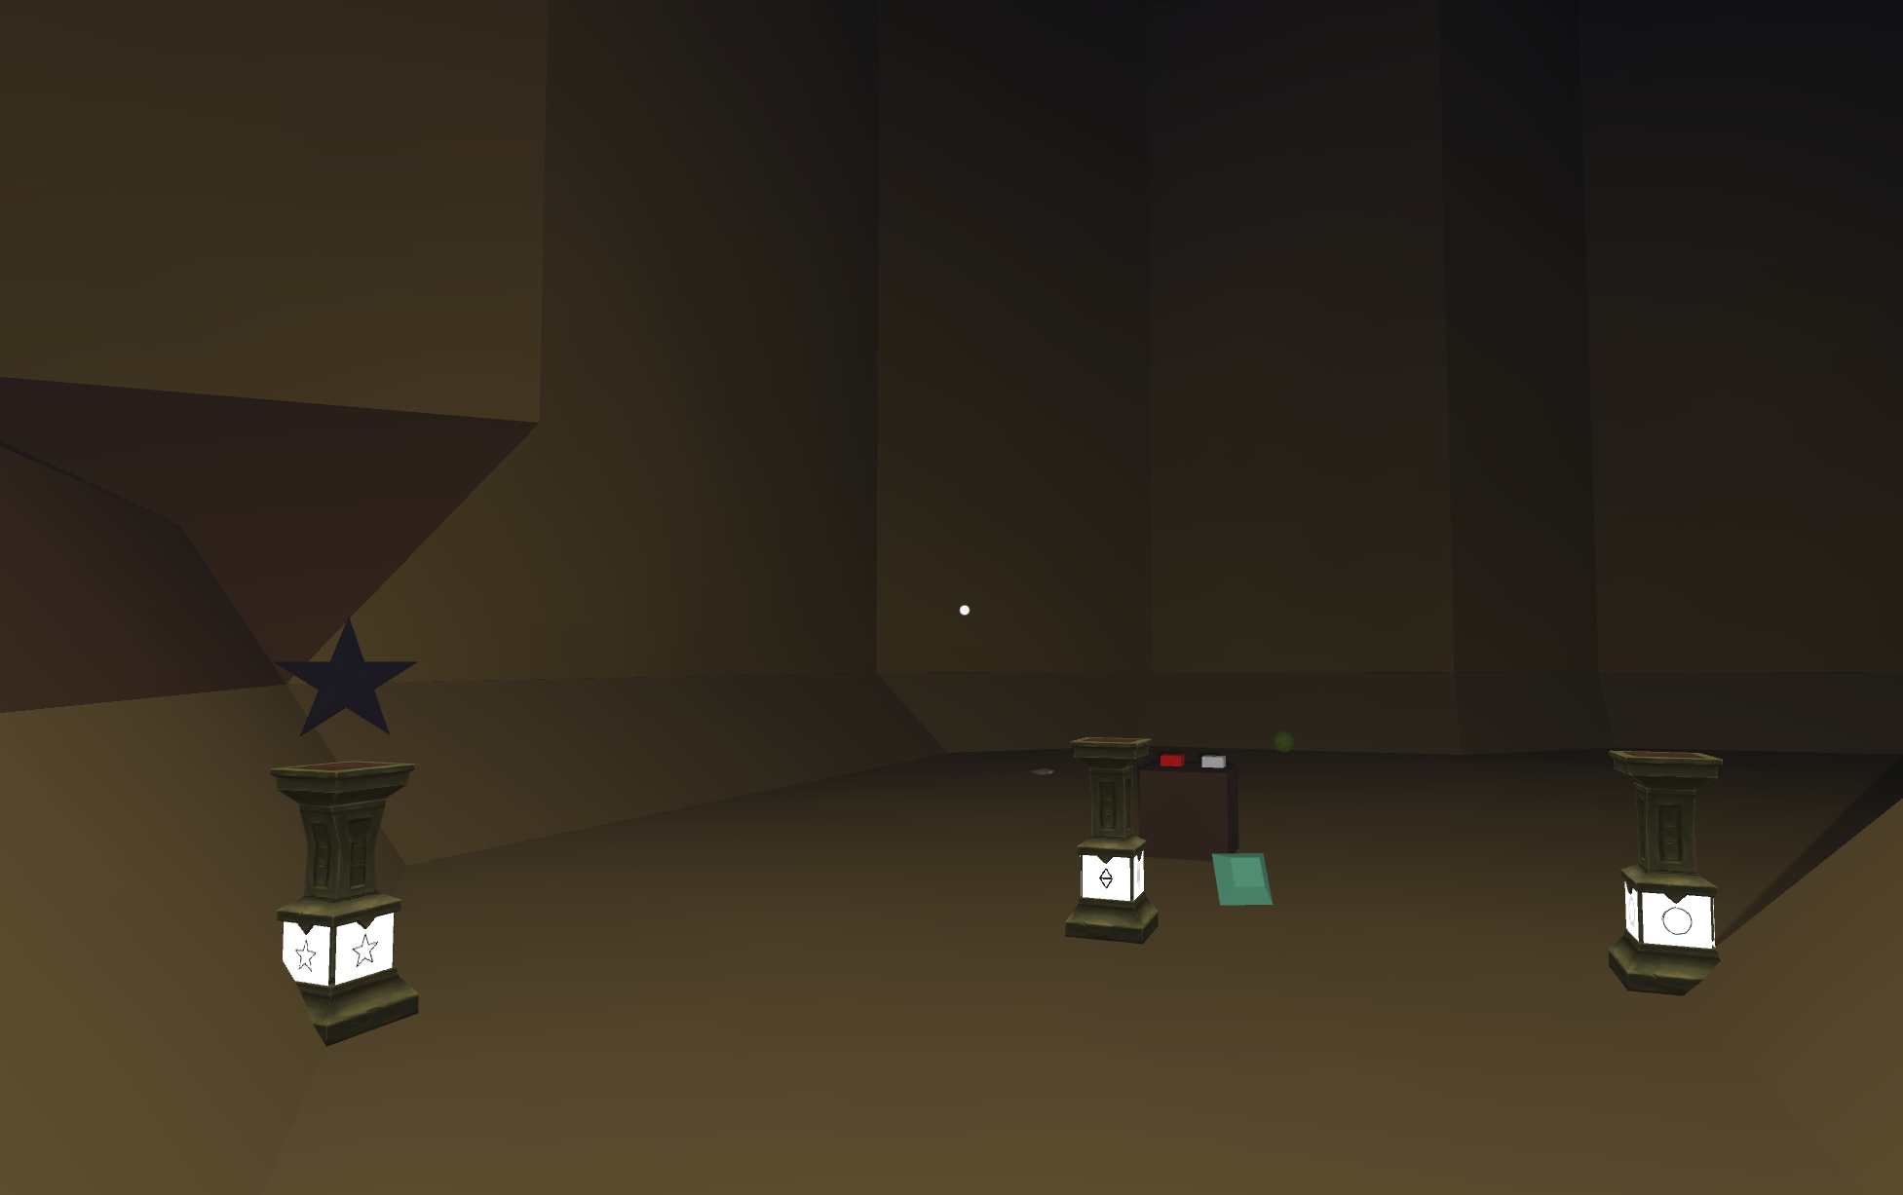
Puzzles
Crystal resonance
Hit the crystals in order to produce a certain sequence of sounds
Each crystal has a different pitch
Hint suggesting the correct order can be found
Gem showcase
Search for various gems to place on the pillars
Each pillar has a hint referring to its gem
Gems can be found in any cave room that is accessible
Crystal resonance
Gem showcase

Slide 9
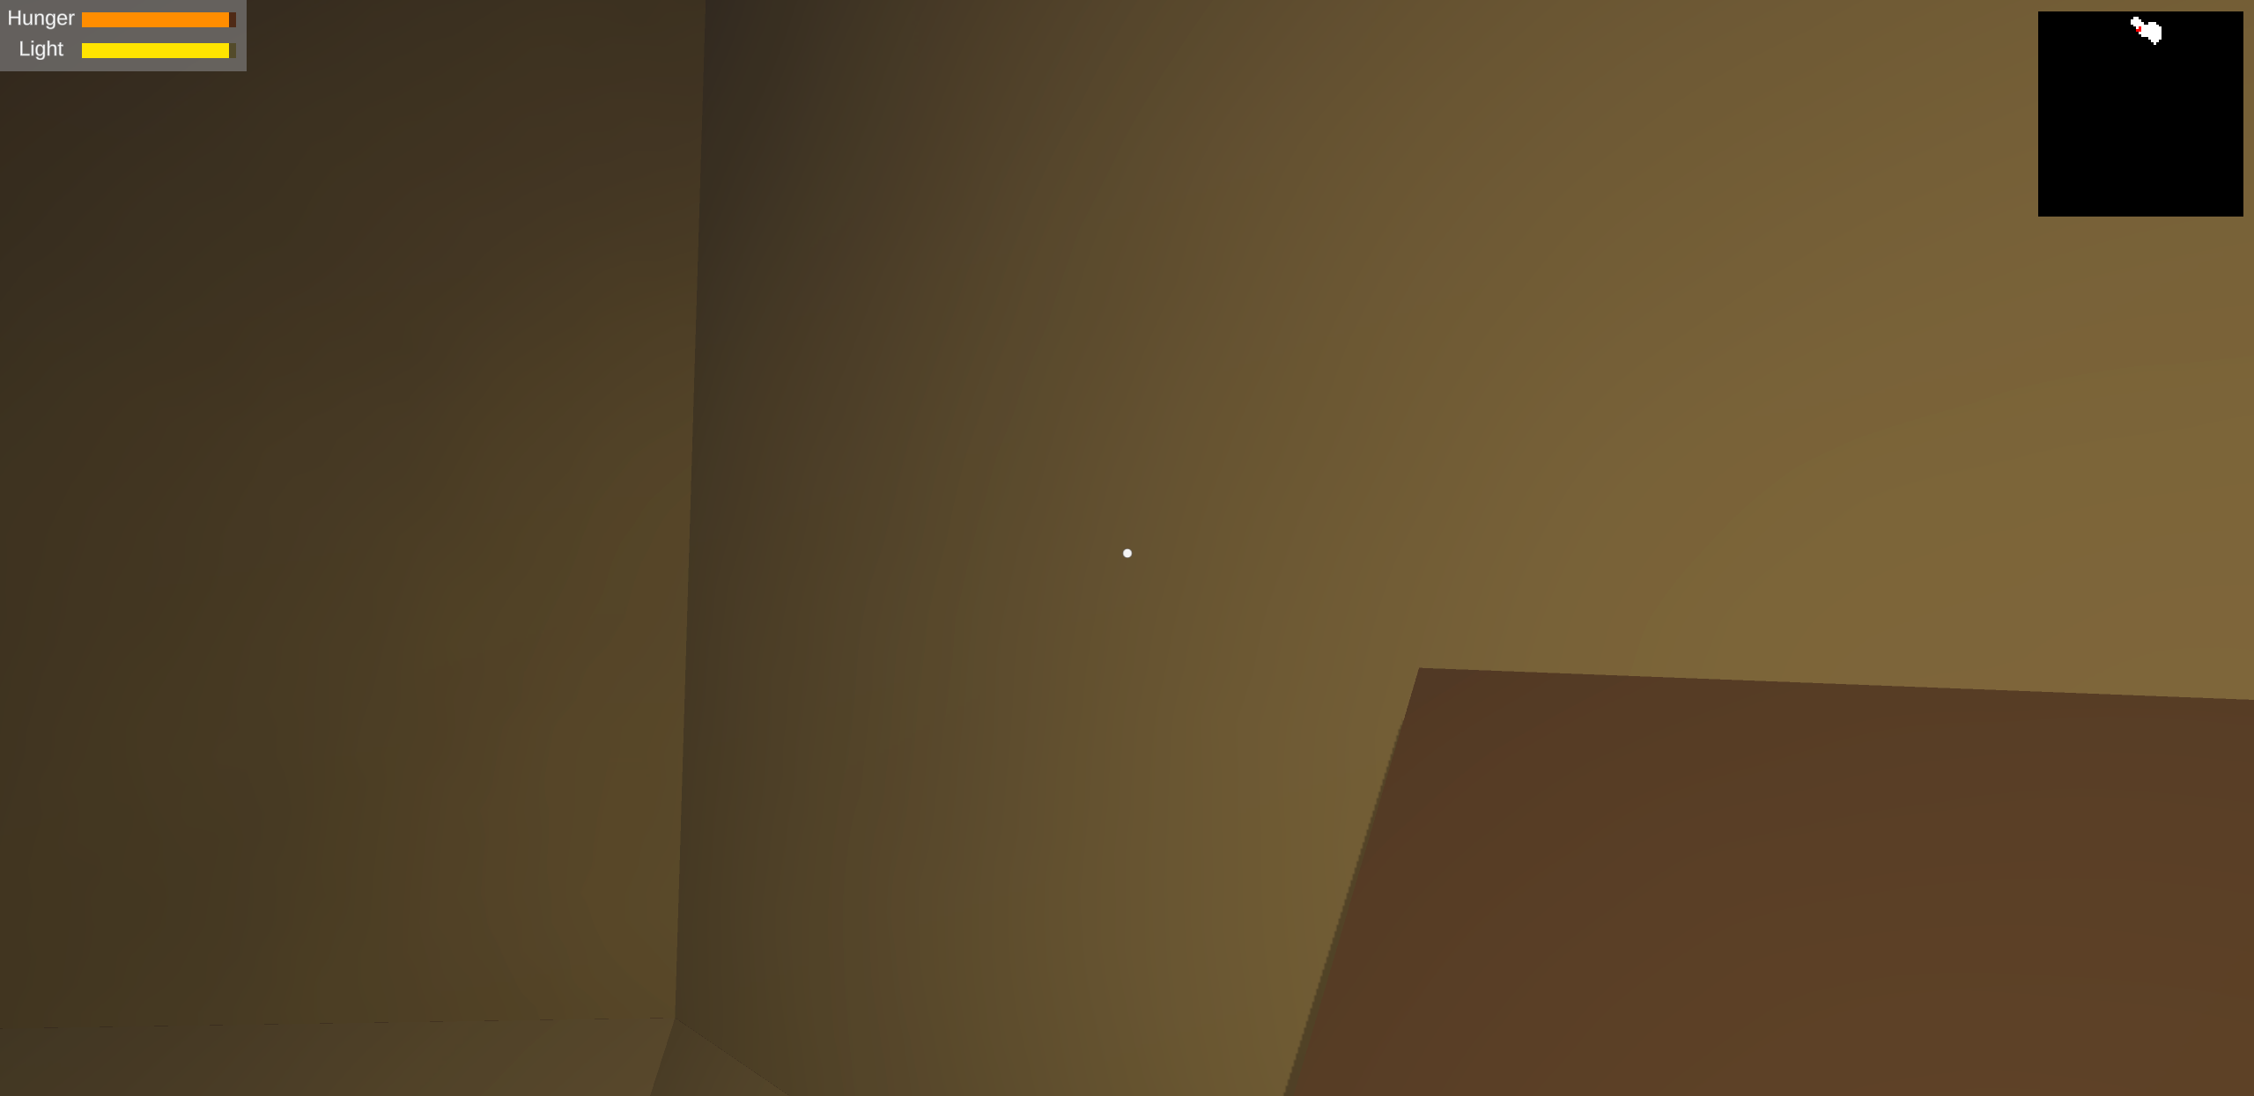
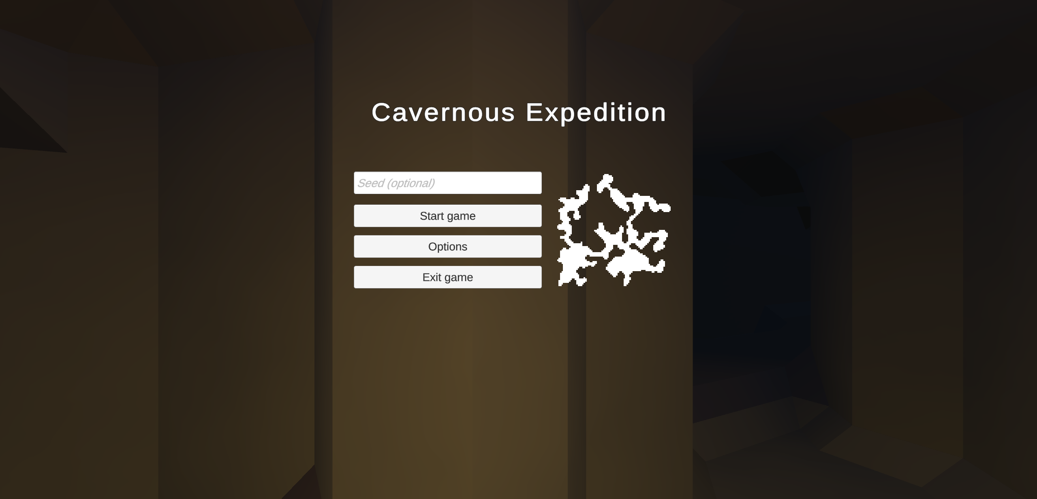
User Interface
In-game UI
Light and hunger levels
Minimap
Crosshair
Main menu
Enter seed
Change settings
Preview map
In-game UI
Main menu

Slide 10
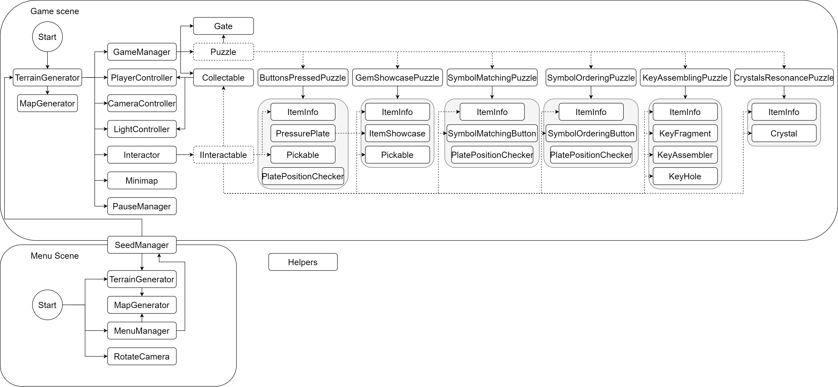
Implementation details
Workflow diagram

Slide 11

Implementation details
Seeded random behaviour
Unity’s random system is state based
Seed is used to set the state
Terrain
Cellular Automaton
Example of a cave system after Cellular Automaton

Slide 12


Implementation details
Terrain
Cellular Automaton
Ensuring connectivity
Cave system partially connected
Cave system fully connected

Slide 13
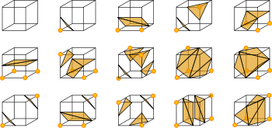
Implementation details
Terrain
Cellular Automaton
Ensuring connectivity
Preparing the data volume
Marching Cubes
Marching cubes cases
Visualization of the Marching cubes algorithm

Slide 14
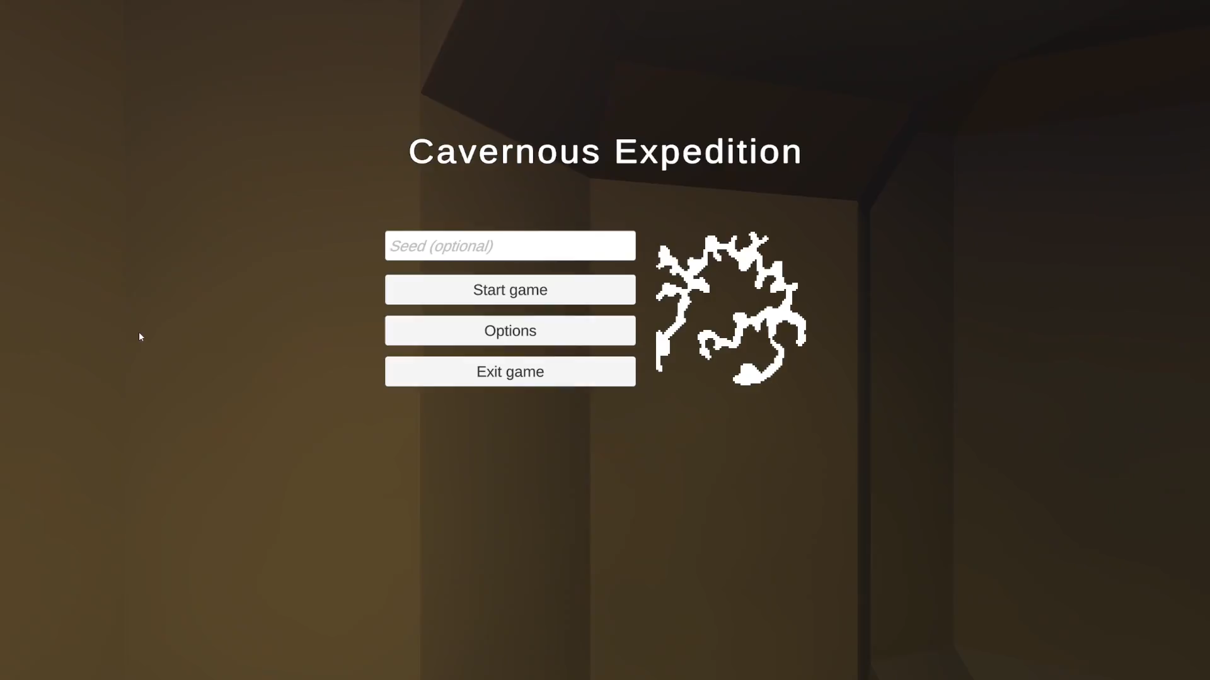
Results

Slide 15
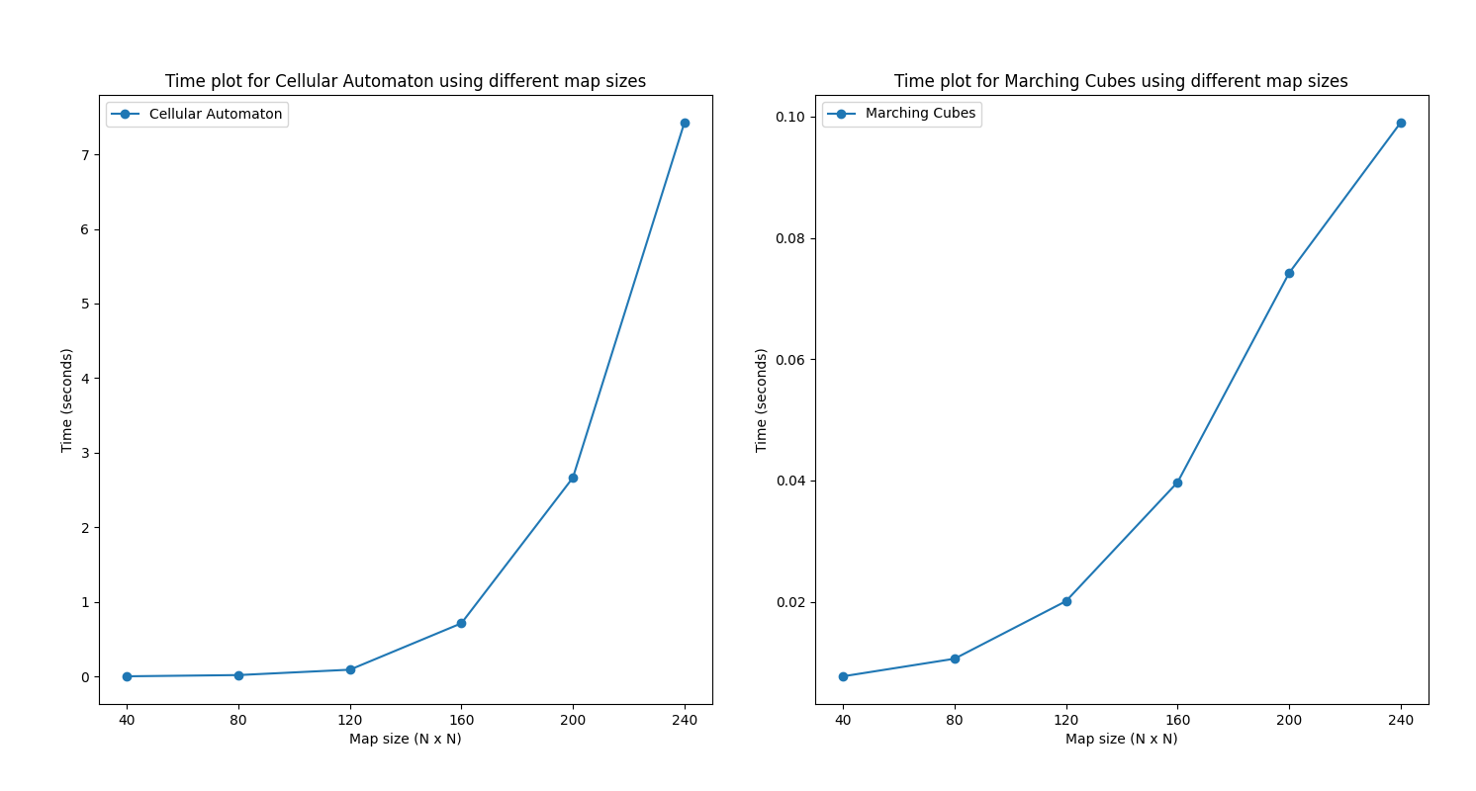
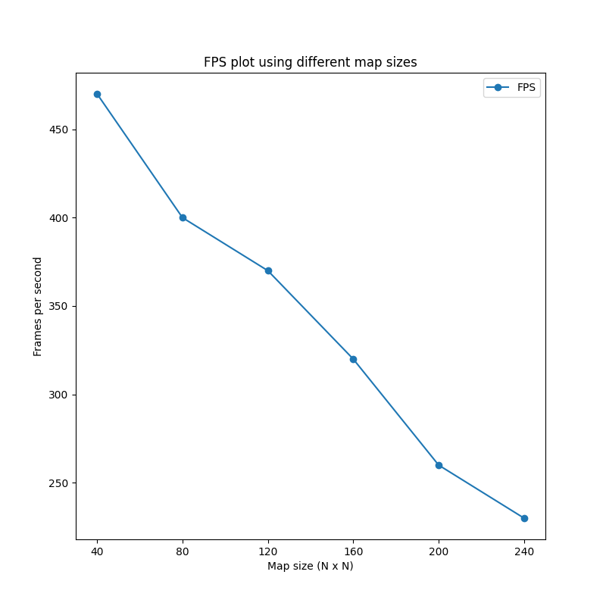
Results
Algorithm performance
Cellular Automaton requires considerably more time than Marching Cubes for bigger map sizes
There is a significant drop in FPS for bigger map sizes
Time plots for Cellular Automaton and Marching Cubes using different map sizes
FPS plot using different map sizes

Slide 16
Results
Feedback
A couple of volunteers were asked to play and rate the game

Slide 17
Future improvements
Parallelizing the cellular automaton algorithm
Splitting the terrain into chunks and rendering only the closest chunks
Cave systems on multiple levels
More details such as stalagmites and stalactites
Themed caves
More customization
Bigger selection of puzzles
Co-op/Multiplayer

